Slide 1
SharePoint Search Health Reports
SearchEngineers@microsoft.com

Slide 2
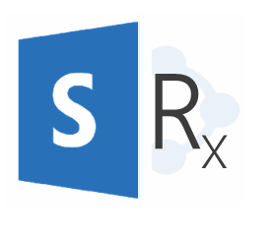
Search Health Reports
Who
All customers that have search enabled in their SharePoint environment.
What
A service available to premier customers which provides a dashboard to combine disparate Search data into one easy to read format. Also includes alerting and proactive monitoring capabilities.
Why
No simple way for our customers to proactively monitor their Search environment and avoid production issues. Currently customers must leverage several different tools and still don’t have access to all the data. Interpreting data requires a skill set that 99% of customers don’t have on their teams.

Slide 3
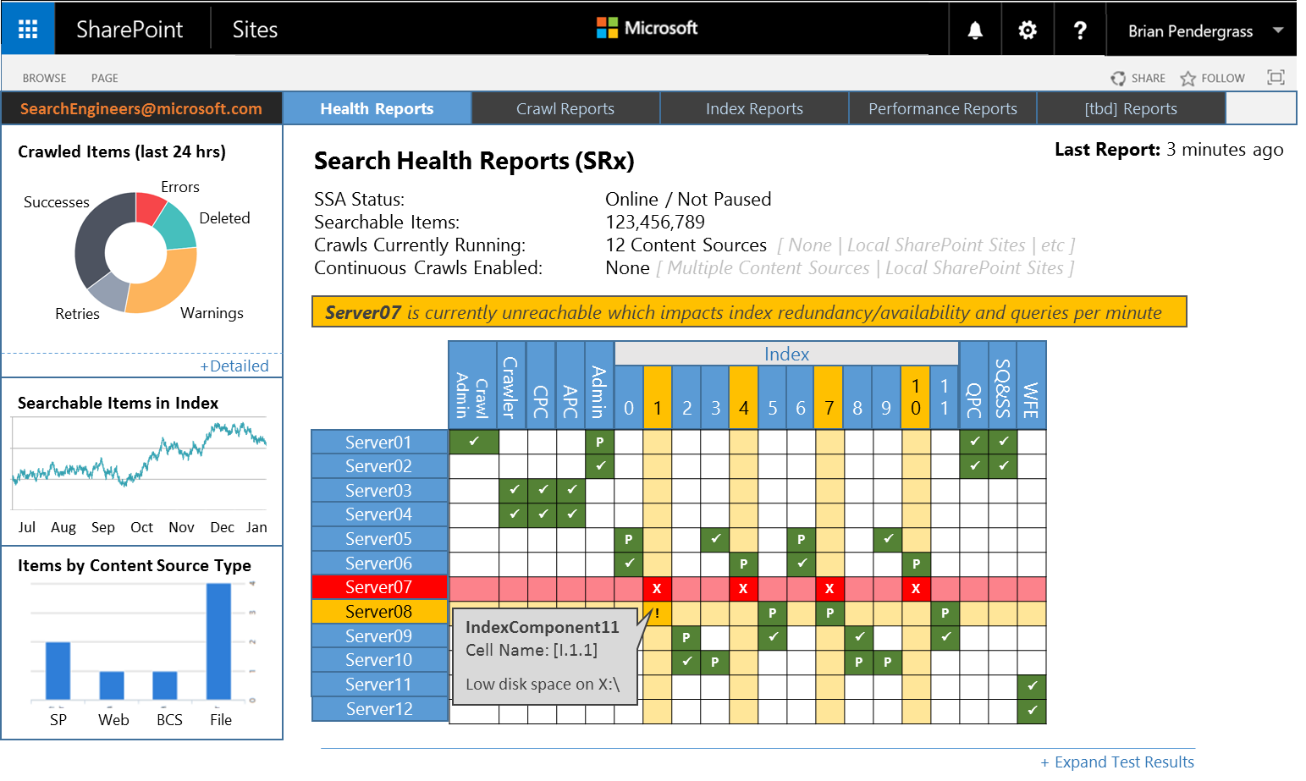
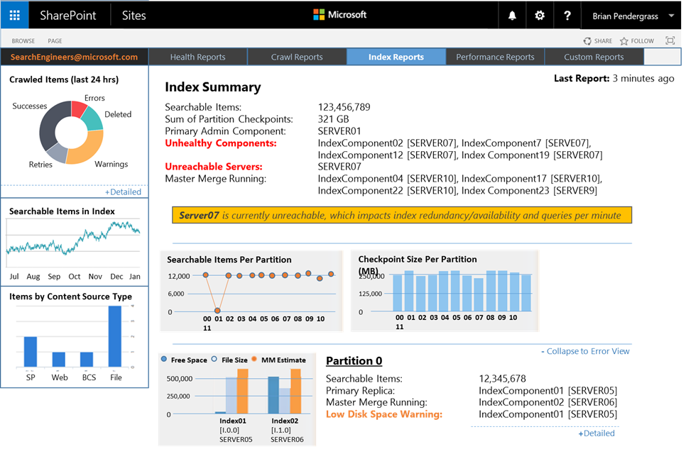
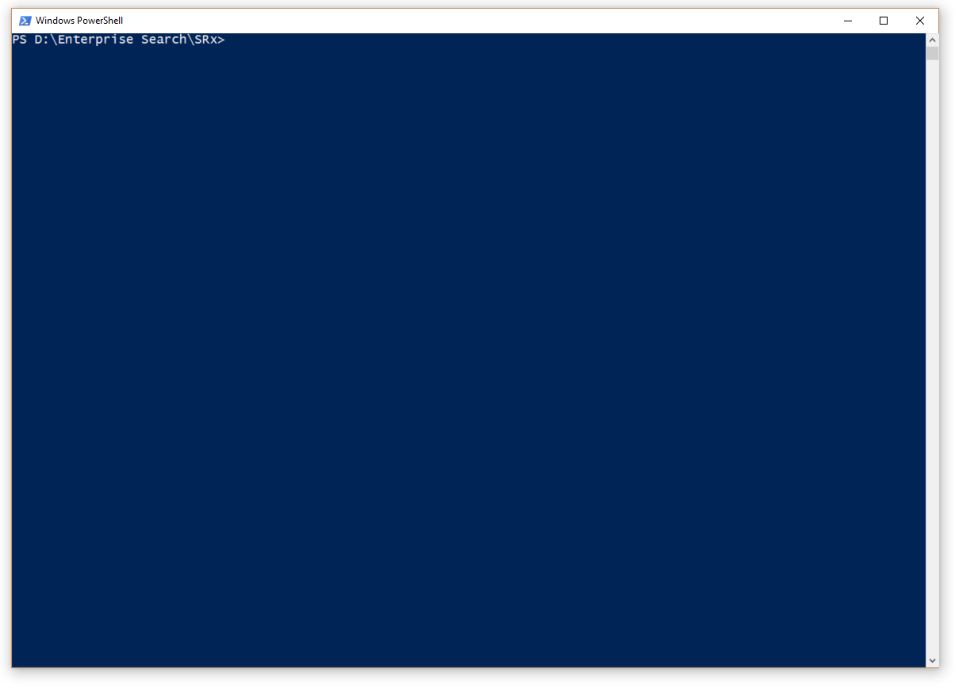

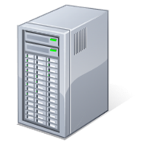

Search Health Reports
Custom PowerShell modules that aggregate diagnostic data from disparate sources.
Scripted tests compare diagnostic data against defined thresholds and expected results.
Regularly scheduled tasks run selected tests to keep Dashboard data fresh.
Failed tests generate alerts.
Custom PowerShell
Test Thresholds
Test Intervals
!
Alert
Search Service Application
Data

Slide 4
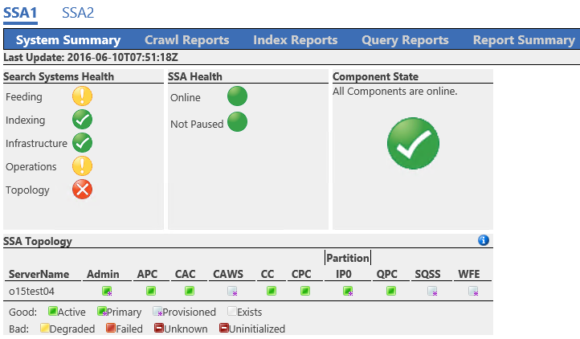
Current Dashboard

Slide 5
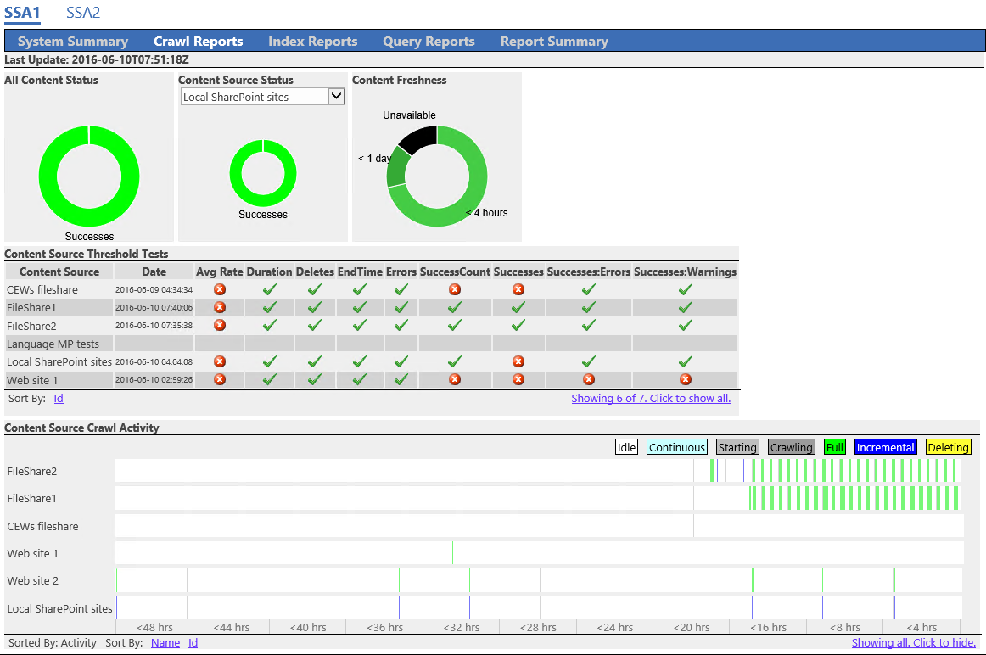
Current Dashboard

Slide 6
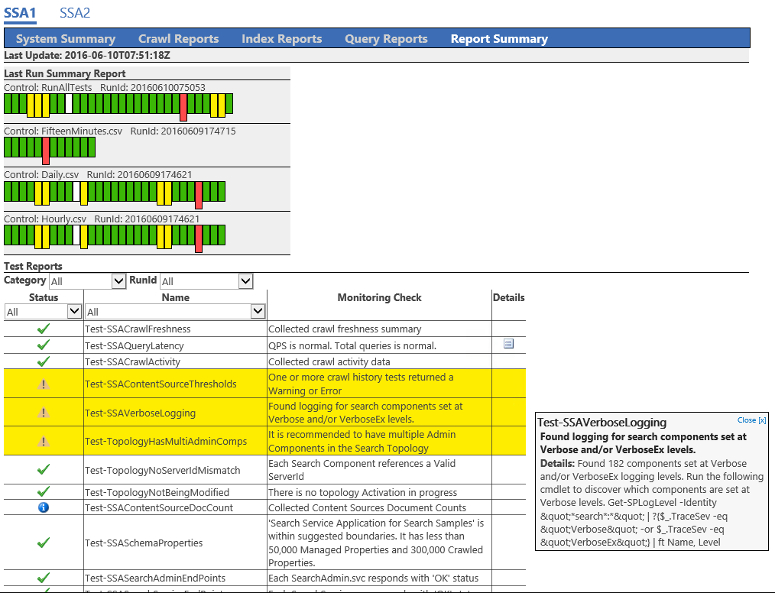
Current Dashboard

Slide 7
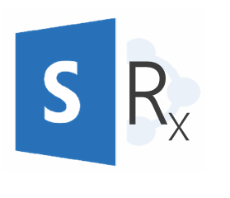
Search Health Reports
SearchEngineers@microsoft.com

